Slide 1

AGURI BRAND & PASCAL IMITATION JEWELRY
T2207E – SEM 1 – GROUP 2
12.2022

Slide 2

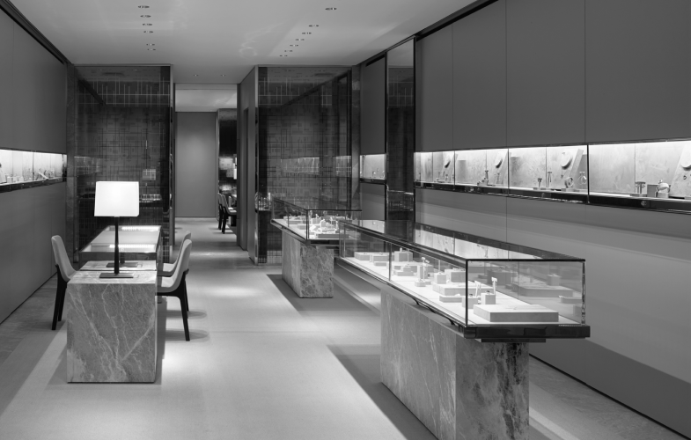
About us
“PASCAL IMITATION JEWELLERY” is one of the leading manufacturers and suppliers of Precious, Semi precious and Artificial Jewelry. They sell them under different brand names. The Quality of the products are renowned for striking features such as smooth polish, stunning design and excelling clarity, look and feature, luster. The shop owner wishes to have the website of the jeweler shop where in they want to describe all the type, brands of the product.

Slide 3



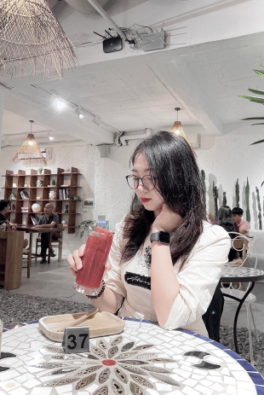
Our team

Slide 4
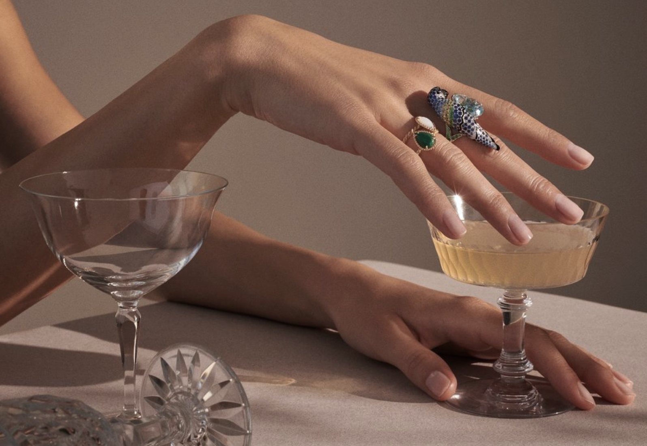
Implementation Environment
(1) HTML5/ CSS/ TypeScript
(2) Boostrap / Jquery
(3) Node JS
(4) MySQL

Slide 5
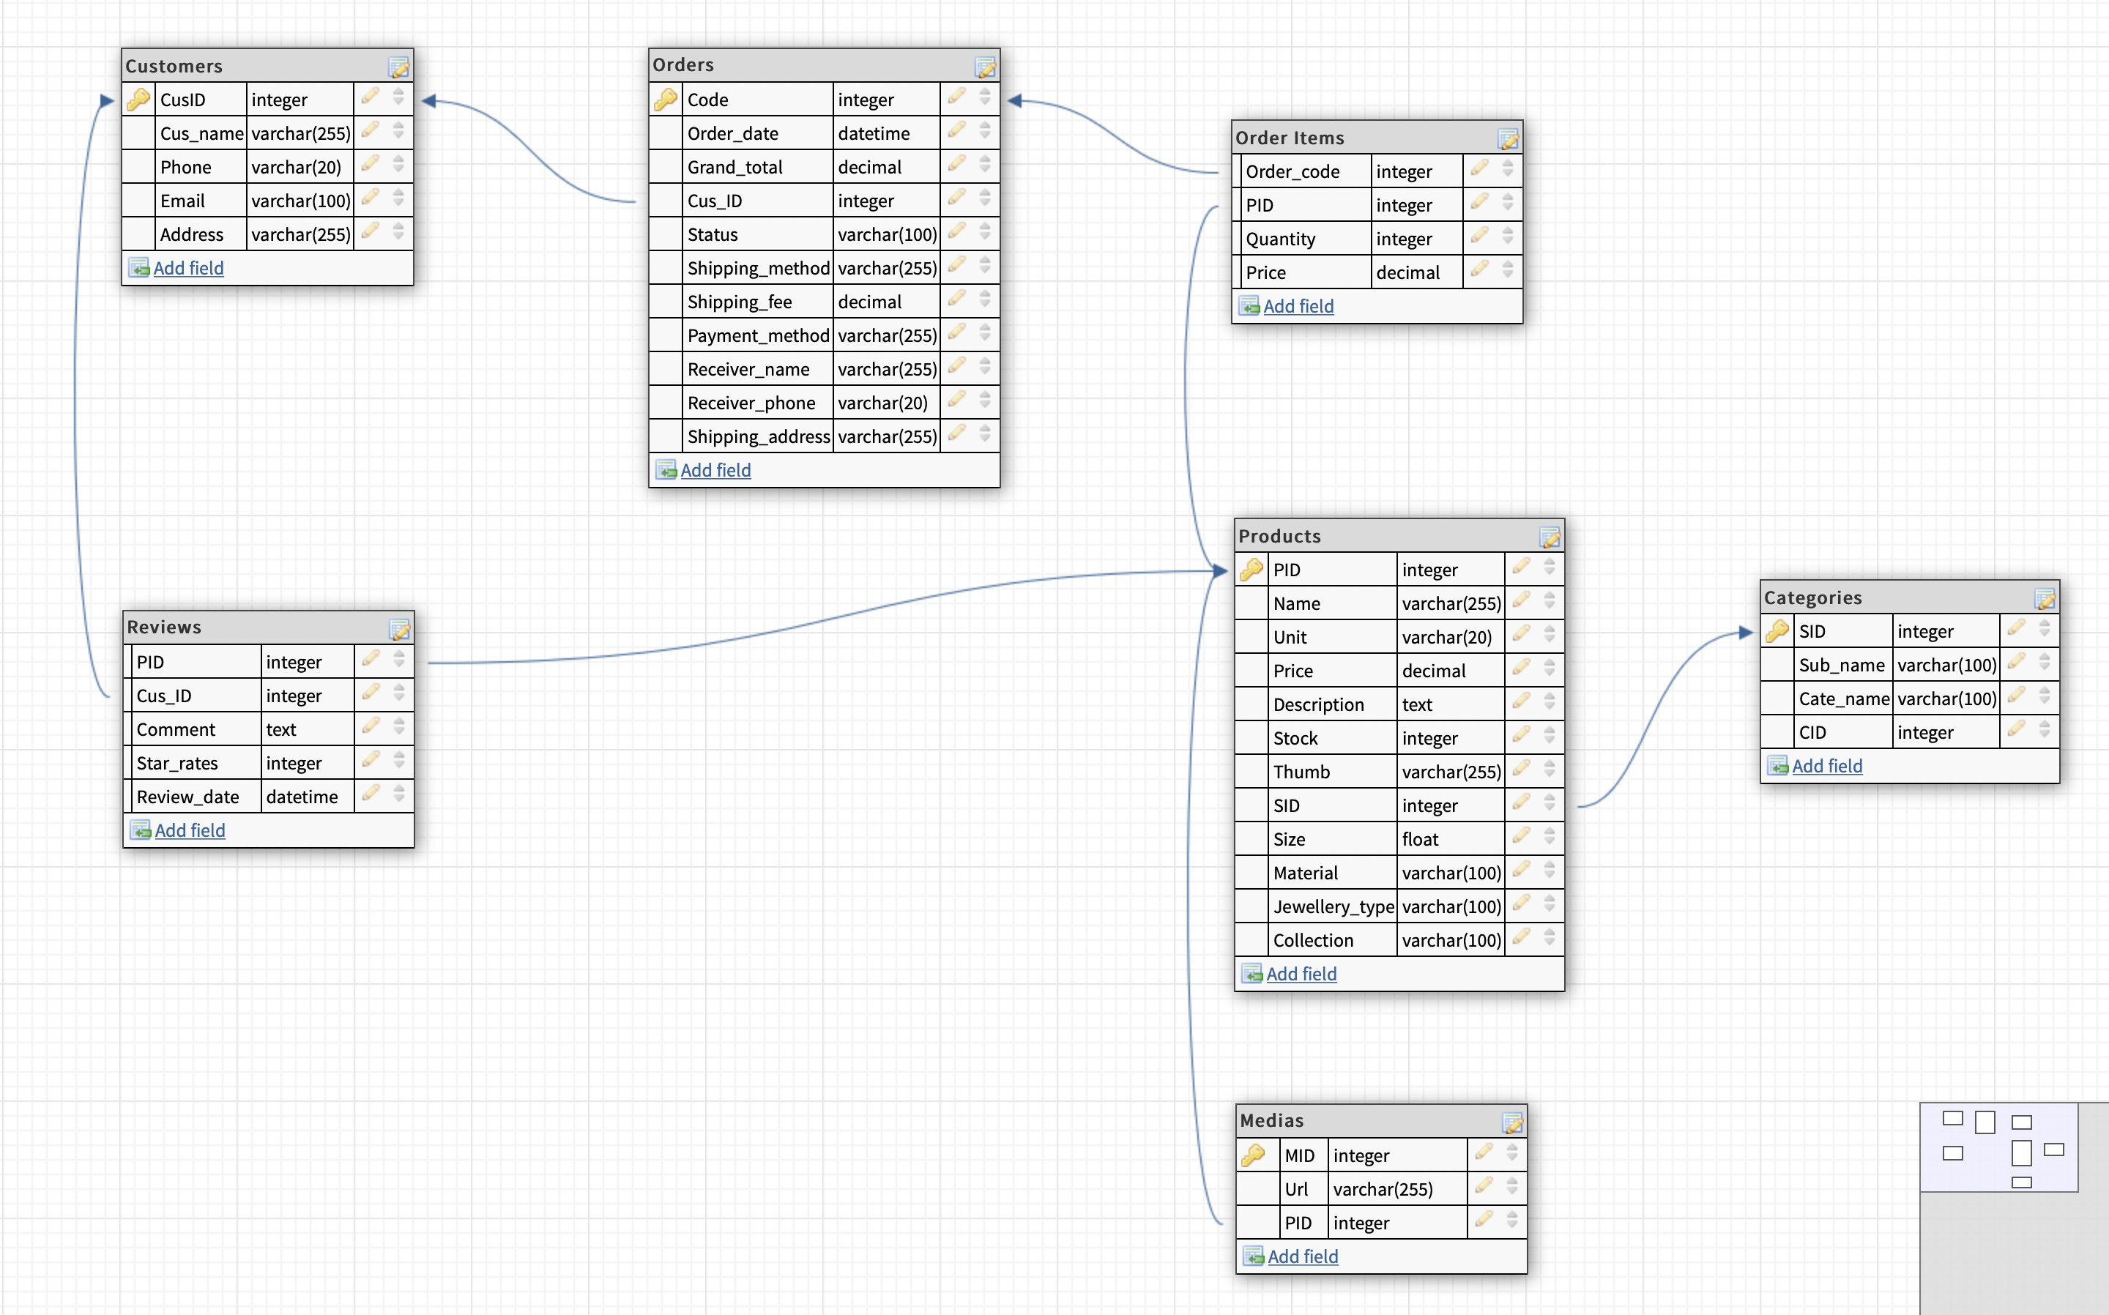
D b d I a g r a m

Slide 6
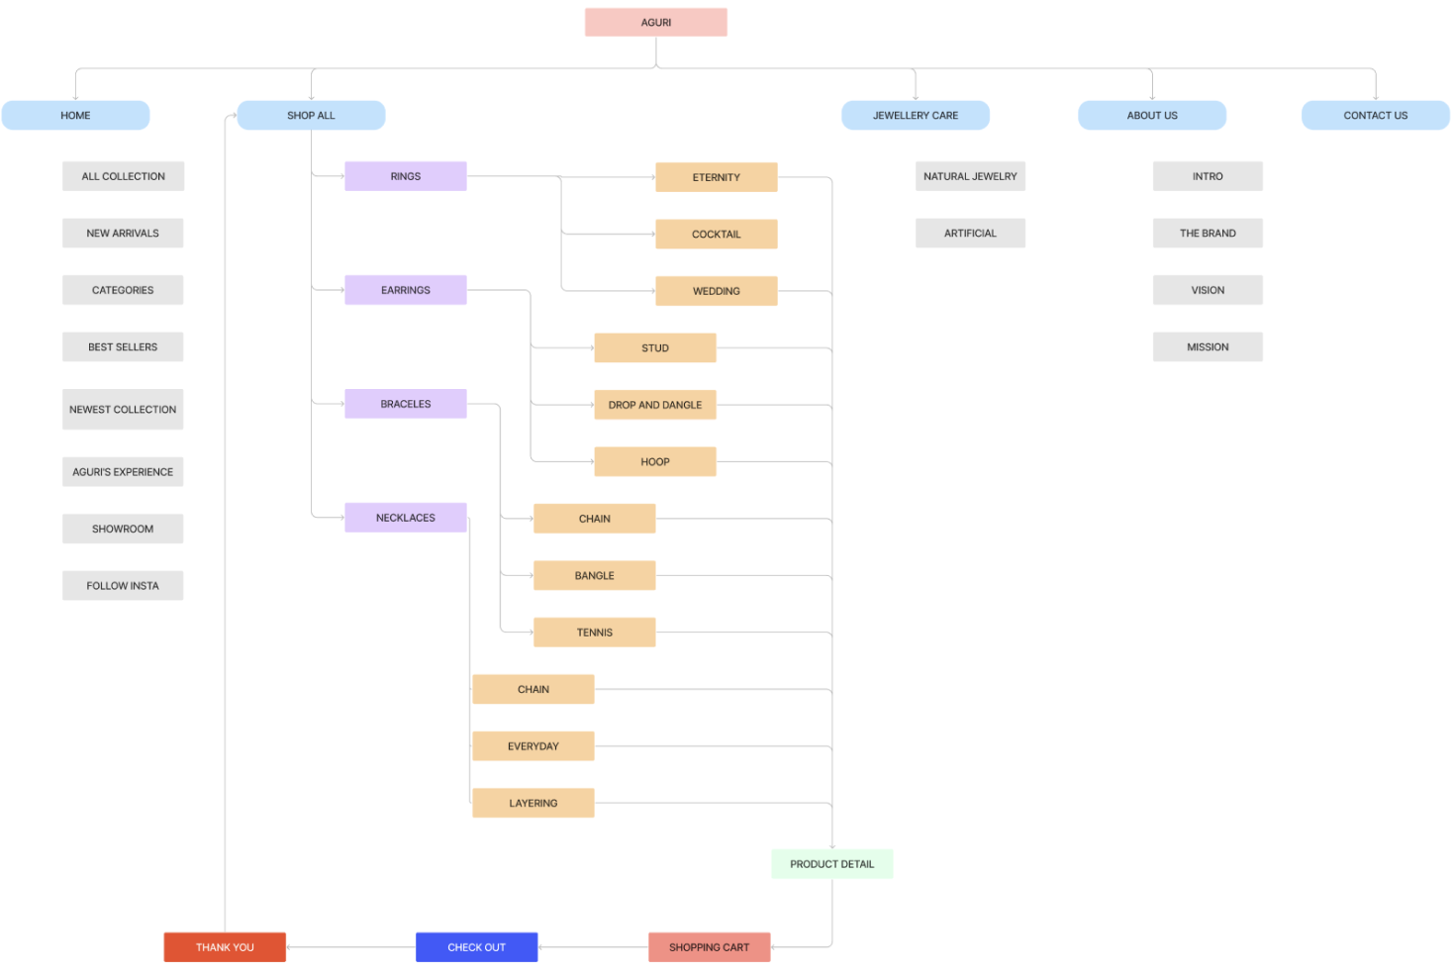
S I t e m a p

Slide 7
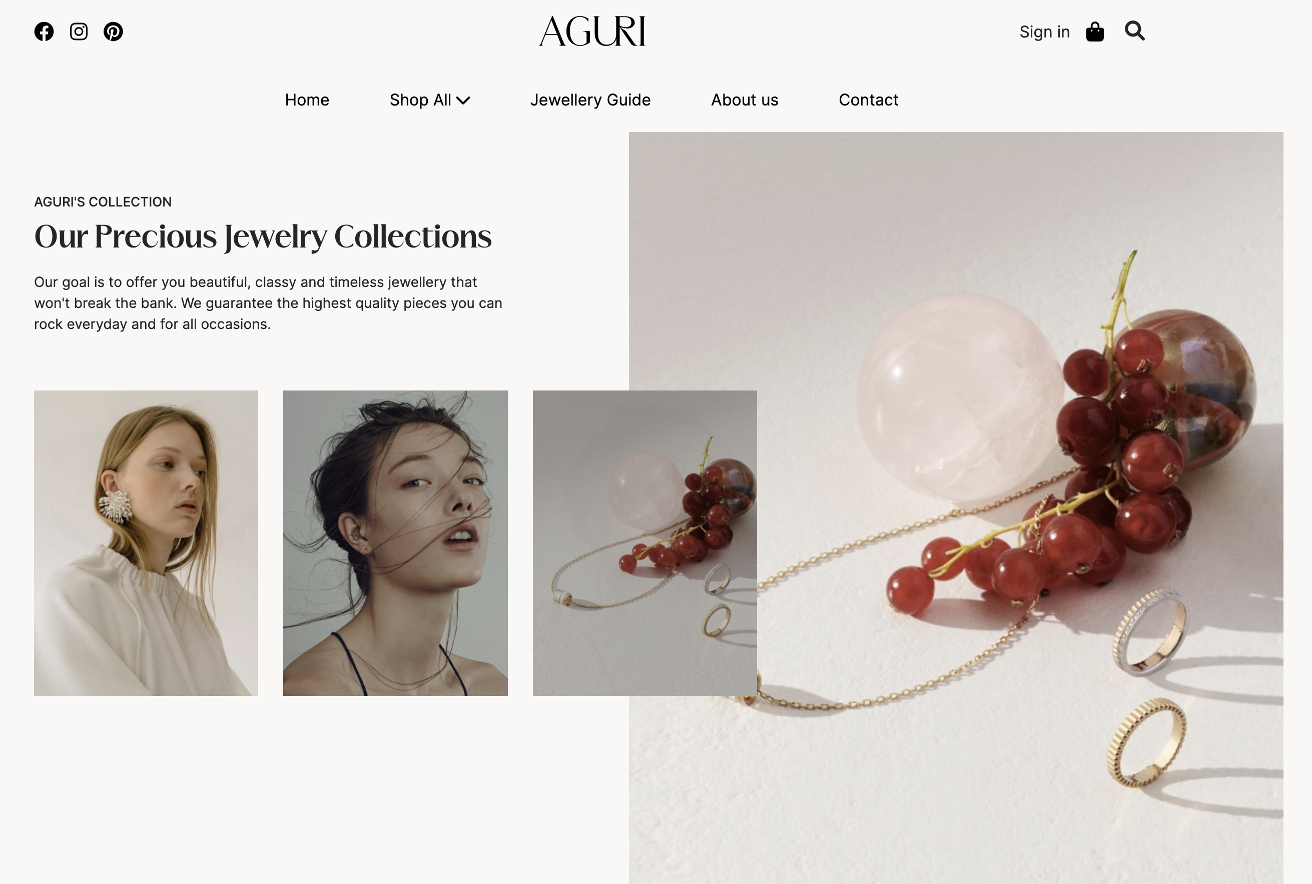
D I s p l a y

Slide 8
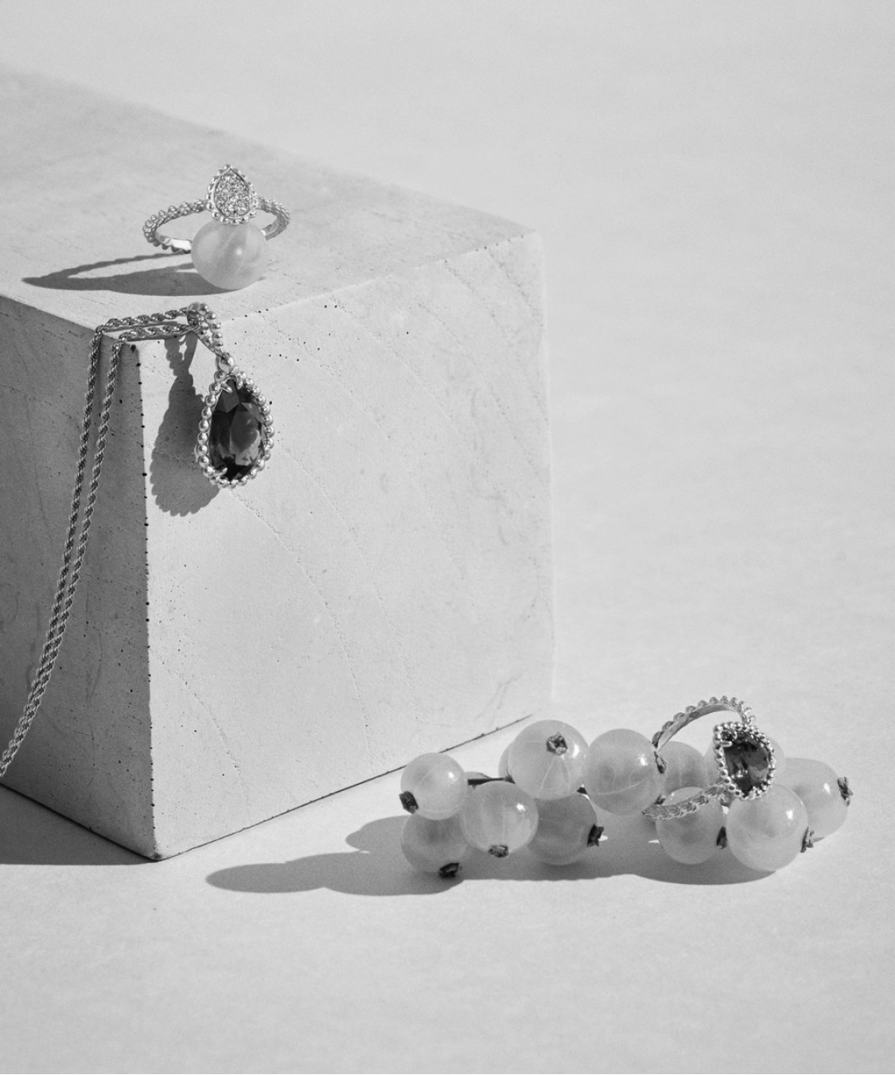
Functions
AGURI
Product
About us
Contact us
Our showroom
Follow us
Guide

Slide 9
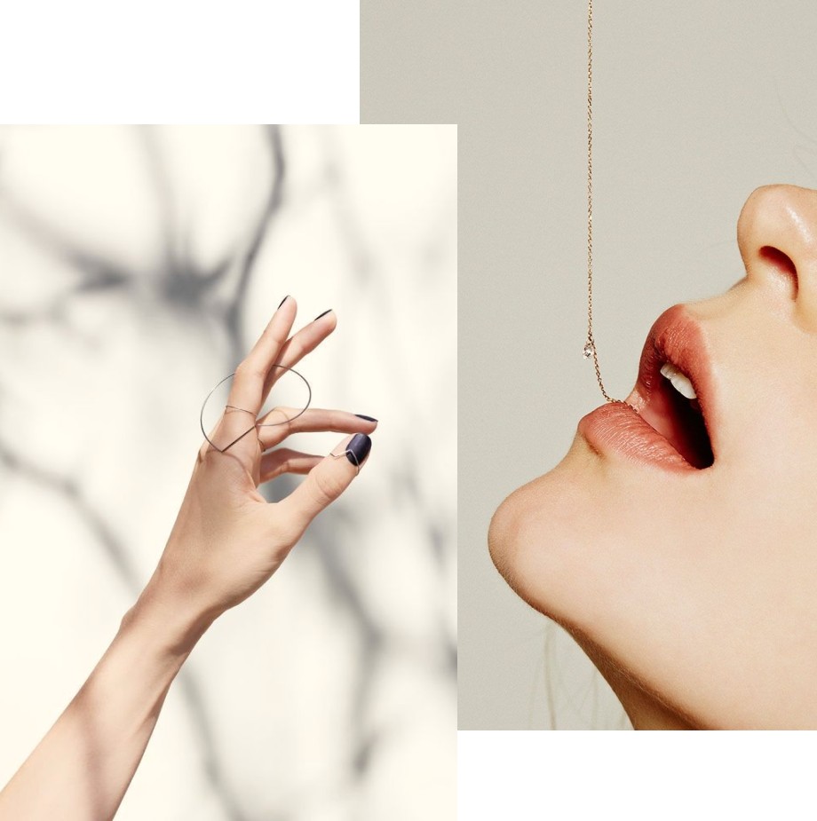
Categories & sub-categories
New arrivals
Best seller
PRODUCTS

Slide 10
Products
Search
Quick view
Compare
Add to Cart
Detail
Filter

Slide 11
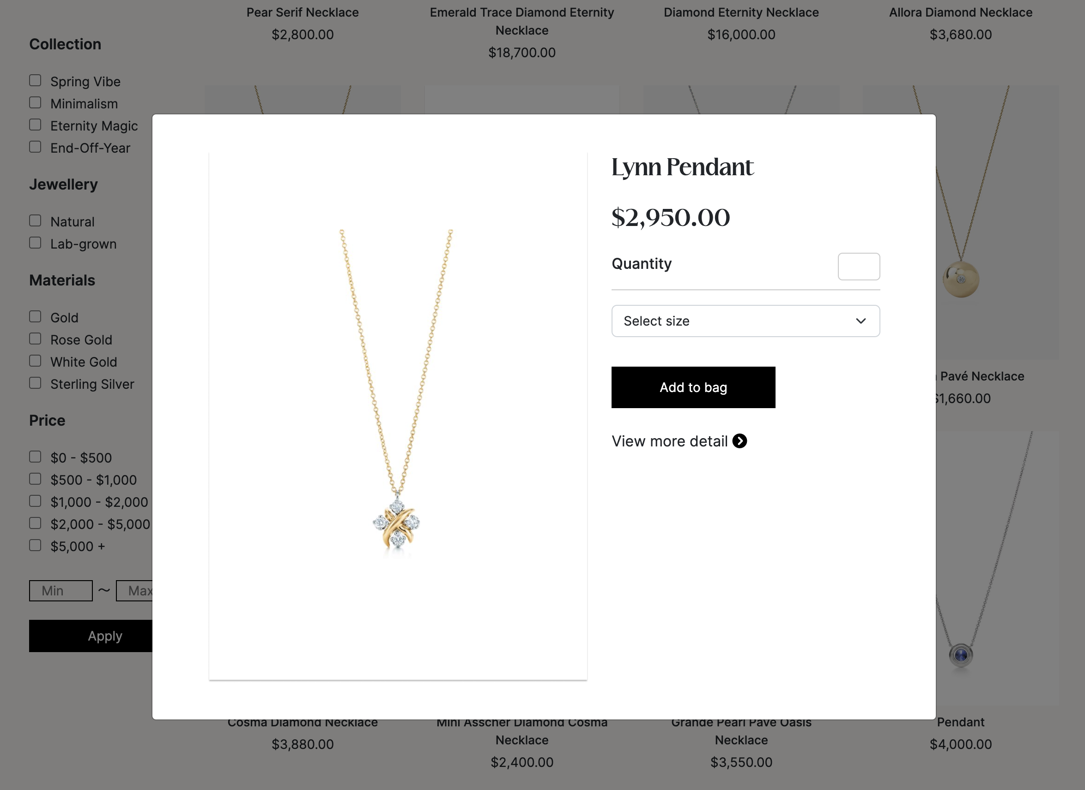
Quick view
The quick view feature makes it easier for your customers to view the key product information such as features, images, and variants by displaying a brief overview without heading to the product details page.

Slide 12
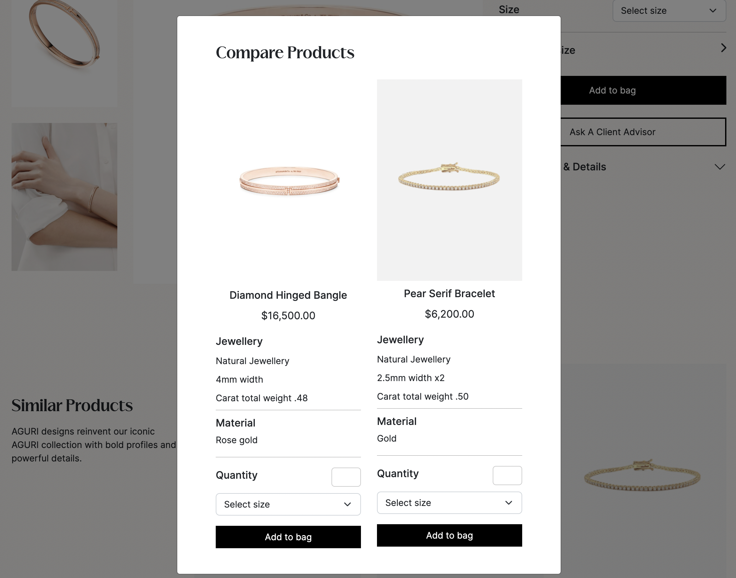
Compare products
The compare products feature makes it easier for your customers to compare the similar product information such as material, image, and variants by displaying overview without heading to the product details page.

Slide 13
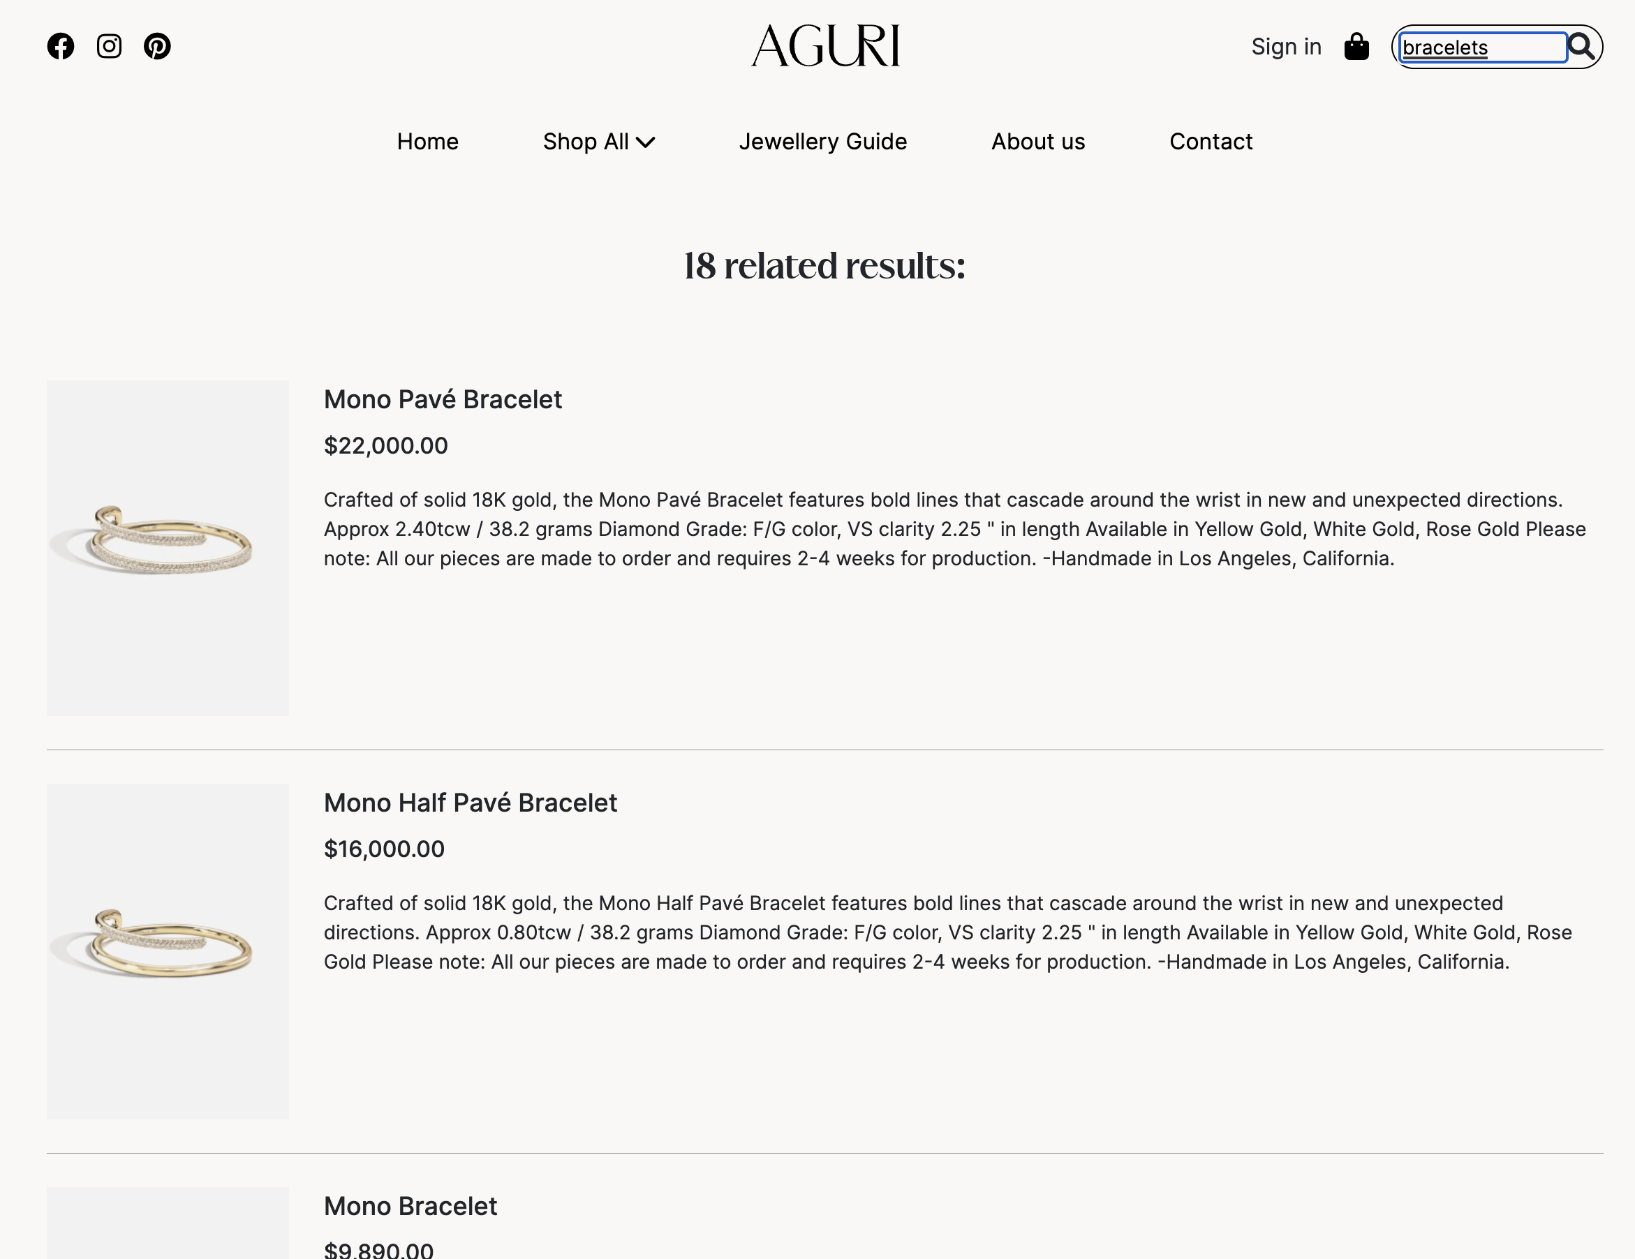
product searching
Searching allows customers to find certain products that satisfy a set of criteria. In the Aguri Brand, we implemented searching simple. Simple searches allow a customer to search the catalog for keywords.

Slide 14
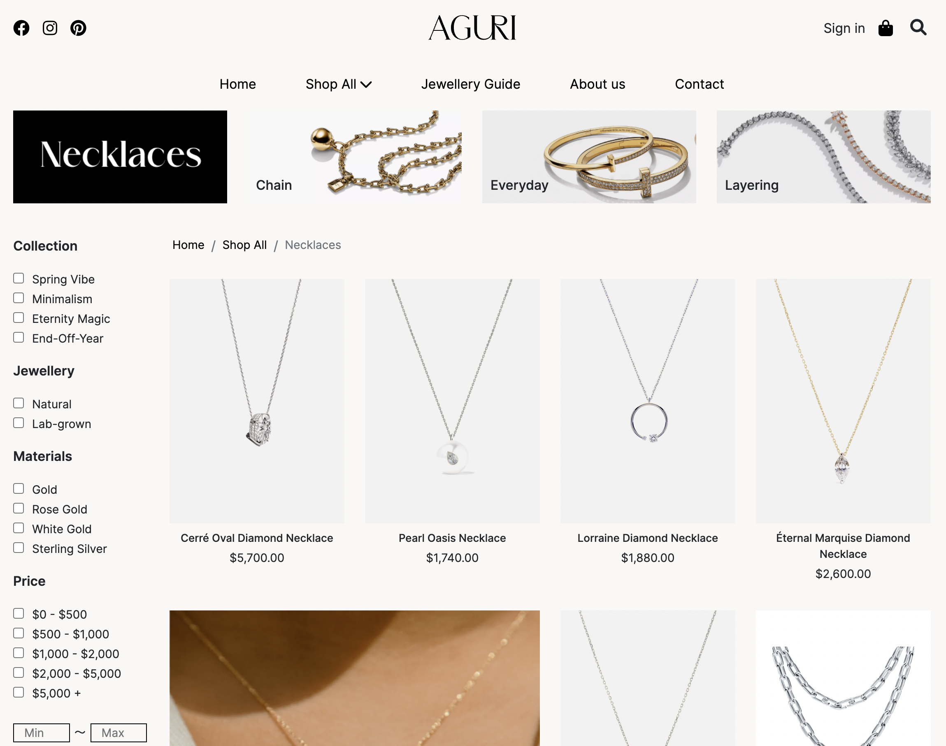
Product filtering
Product Filtering allows shoppers to refine product searches based on multiple attributes like jewellery, material, price... Using filters on your storefront can make it easier for shoppers to navigate products by allowing them to search the way they want to.

Slide 15
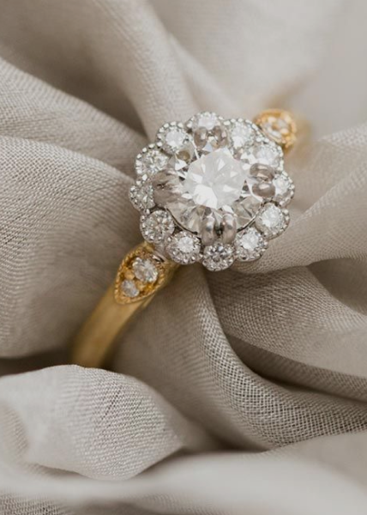
Add-in function
About Natural & Lab-grown Jewellerty
Jewellery Characteristics
Jewellery Insurance
Jewellery care
…

Slide 16
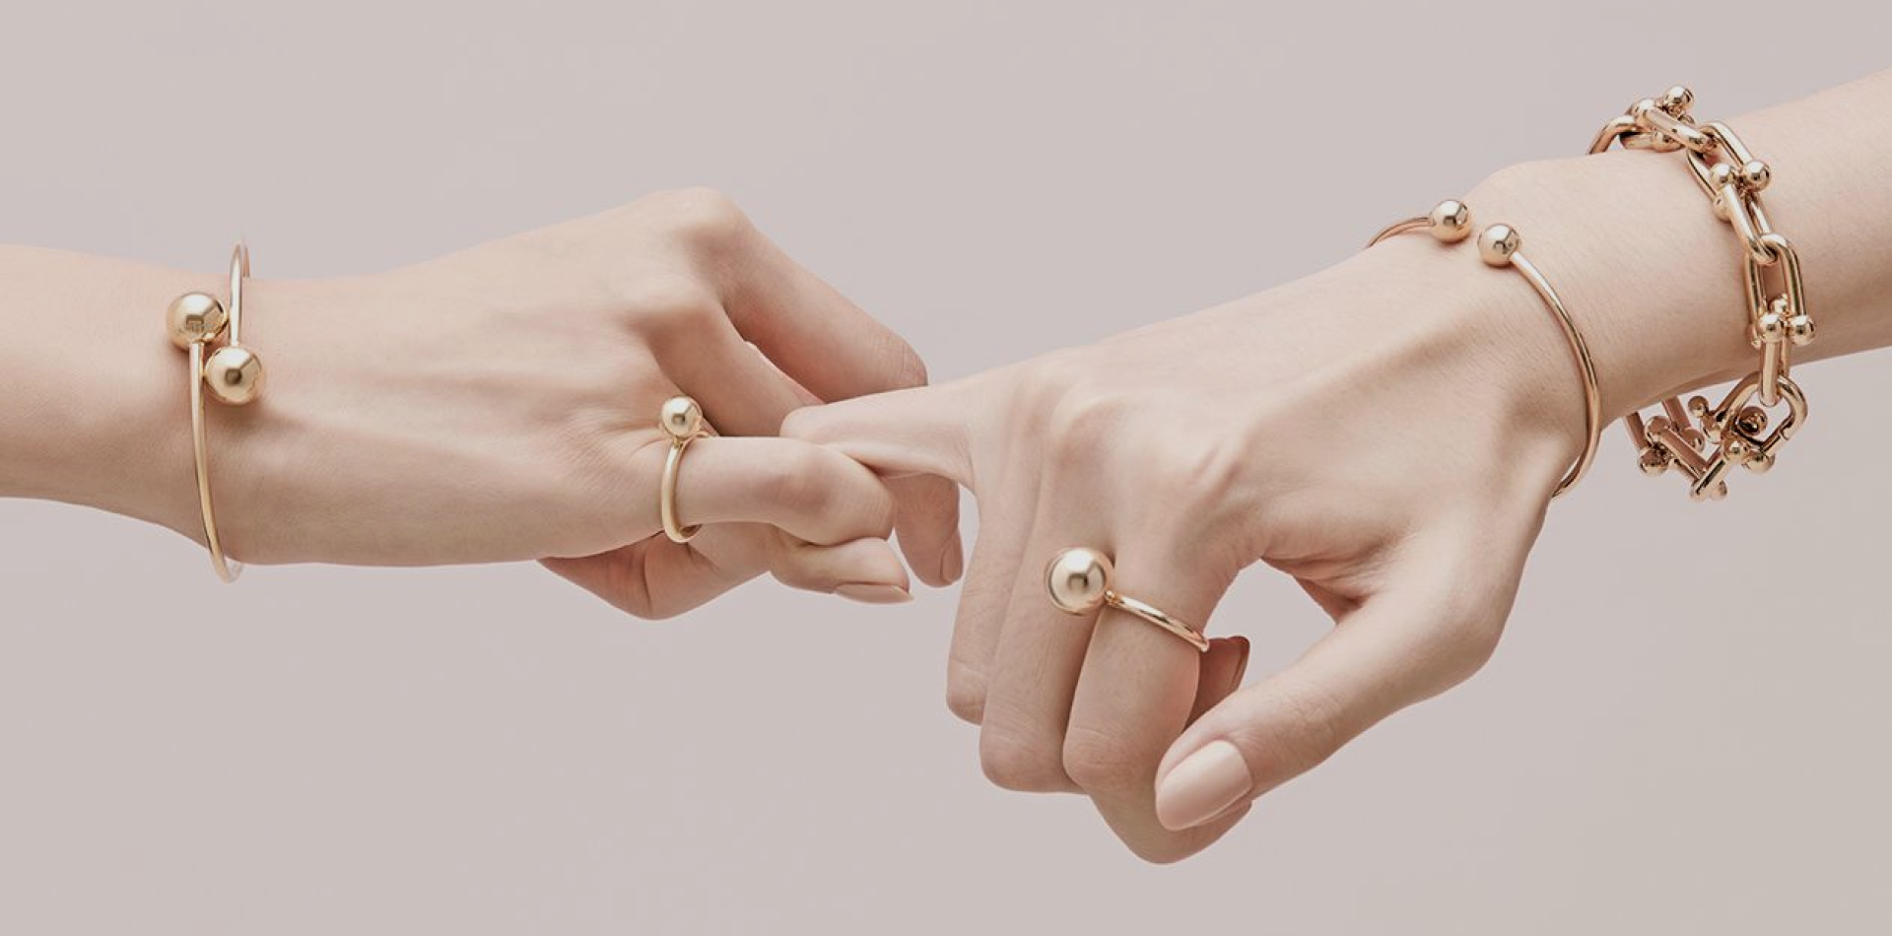
Customers
Sign-up
Sign-in
Buy products
Review
Feedback

Slide 17

shopping
Add to bag
+/-
View back
Check
Check out
Information
Tracking order

Slide 18
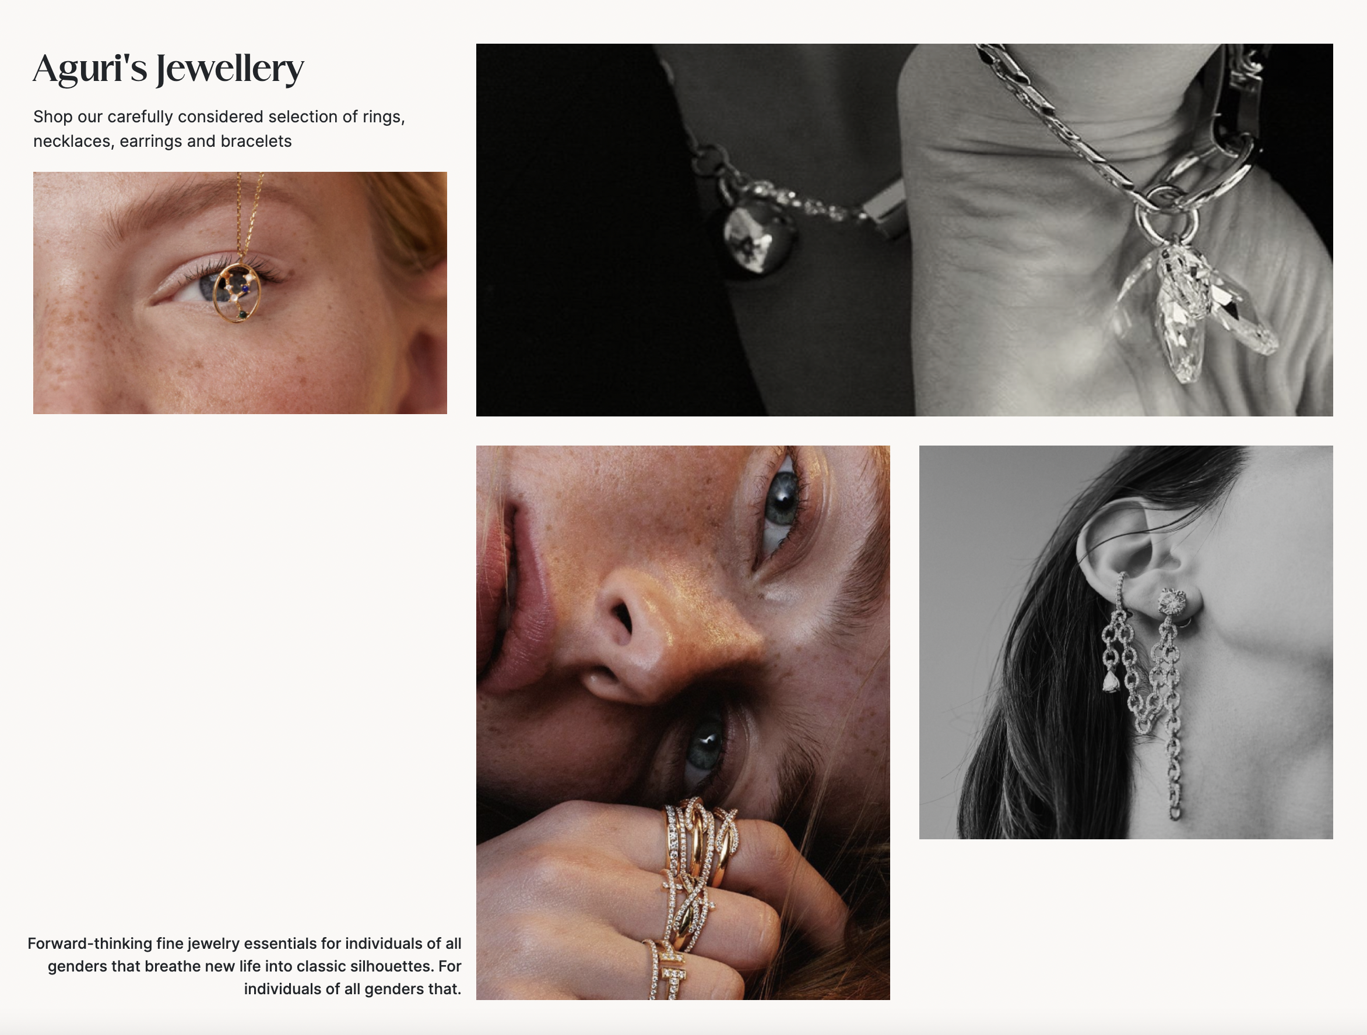
W E B S I T E

